Slide 1

Caregiving Resources
@

Slide 2
Debra J. Kakuk Smith
MA, MLIS
Professor, Health Sciences Librarian
College of DuPage
smithkak@cod.edu

Slide 3
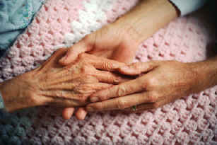

Caregiving Quick Facts
Caregiving is:
  physically,
  mentally,
  spiritually
  & emotionally challenging
39% of American adults (4 out of every 10) care for adults or children with significant health issues¹
an additional 1.4 million children care for dependent family members²

Slide 4

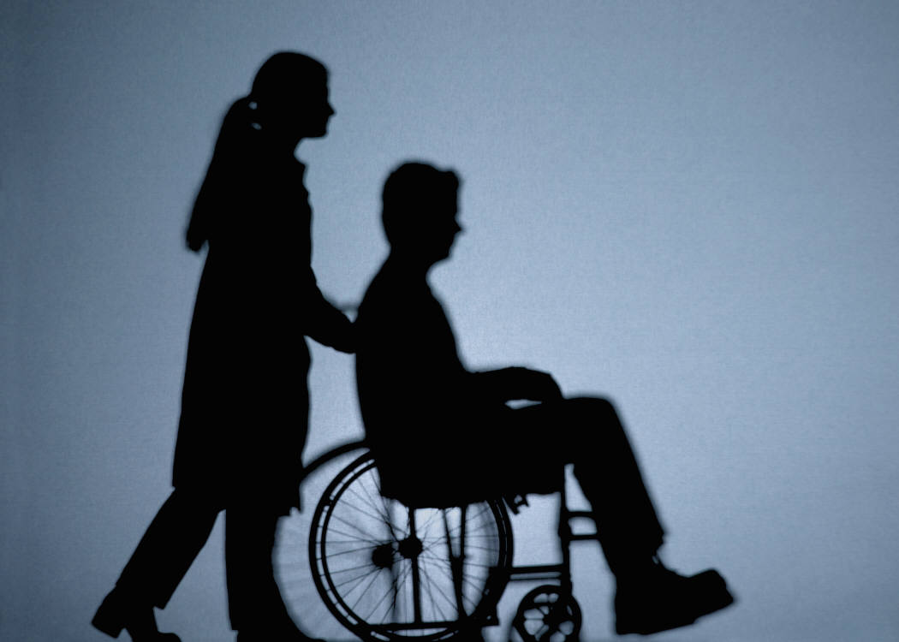
Caregiving Quick Facts
Caretaking impacts the
U.S. Economy
1/3 of working caregivers miss an average of 6.6 days of work per year
  126,222,624 total lost days
  $25.2 billion in lost productivity³
the hours children (18 and under) spend caretaking are not included in these figures!

Slide 5

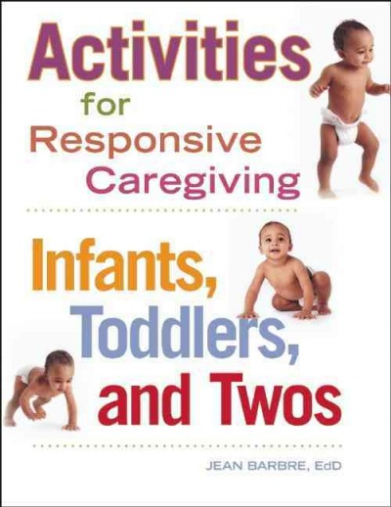
Caregiving Resources
Resources
Come in all formats,
Online
Multimedia
  DVDs
  CD-ROMs
  VHS
Print

Slide 6


Caregiving Resources
Resources
Address:
Day-to-day concerns
Practical needs
Caregiving Stress
Specific types of caregivers and/or patients
Assistive technology
Legal considerations
And so much more….

Slide 7
References
1
2
3

